Slide 1
End User Training
Template

Slide 2
How to use this Deck
What you need to do next:
Review the decks and apply any branding needed.
Add and remove slides based on the training needs.
Update slides with your specific processes.
Follow prompts notated with a pink box - remove the box when finished.
Replace any screenshots that appear outdated or do not match what is found in your instance.
TIP: Make copies of the decks and save a different version for each end user training:
We've put together a selection of decks to support various Responsive use cases and certain role responsibilities. Some of these decks focus on the fundamentals of content searching, while others delve deeper into platform management. All the information is conveniently compiled in one place, allowing you to easily access the resources you need based on how your team uses the tool.
xx
TIP: Remove/hide this slide from final presentation
EXAMPLE: Project Management Training
For users that create and respond to projects
Introducing Responsive (Slides x-x)
Managing Projects (Slides x-x)
Collaboration (Sides x-x)
Content Searching (Slides x-x)
EXAMPLE: Content Owner Training
For users that get invited to collaborate on projects
Introducing Responsive (Slides x-x)
Content Management (Sides x-x)
Content Searching (Slides x-x)
Remove/ hide this slide from final presentation

Slide 3
Who is this guide for: The Basics
Guide: Introducing Responsive
Intended Audience: Everyone new to Responsive - should be included in all beginning training sessions
Before anyone learns about the platform, they should have a basic understanding of what it is, why it was purchased and how to access it.
Use these guides to kick off all training initiatives with your teams.
Guide: Setting Up Your Account
Intended Audience: Everyone new to Responsive - should be included in all beginning training sessions
Confidential | © 2024, Responsive. All Rights Reserved.

Slide 4
Who is this guide for: Response Projects
Guide: Managing Projects
Intended Audience: Users who will be responsible for owning projects in Responsive. Tasks include creating projects, importing and exporting. Note: Contains functionality only available to users with Manager and Admin permissions.
There are two key elements to working in Response Projects: owning the project and responding to questions.
For project owners:
Use both guides
For authors/reviewers:
Only use Collaboration guide
Intake is optional based on your process.
Guide: Collaborating Within Projects
Intended Audience: All roles responsible for answering or reviewing questions within projects.
Guide:Making Go/ No Go Decisions in Projects with Intake
Intended Audience: Optional depending on process - any user in charge of managing the intake queue for projects. Note: Contains functionality only available to users with Admin permissions.
Confidential | © 2024, Responsive. All Rights Reserved.

Slide 5
Who is this guide for: Content Library
Guide: Content Searching
Intended Audience: Any user that will have access to the content library. Recommended for all Responsive users.
Every user should learn how to navigate the Content Library, so Content Searching is a must for all new Responsive users.
Invite content owners to learn about content management as it will be more focused on maintenance strategies within the library.
AI and Lookup are optional depending on your Responsive package.
Guide: Content Management
Intended Audience: Any user responsible for owning or adding content in the library. Note: Contains functionality only available to users with Manager and Admin roles or ownership/moderation permissions.
Guide:Additional Resources - AI + LookUp
Intended Audience: Optional depending on package - any role who is expected to leverage these additional resources when working in Responsive
Confidential | © 2024, Responsive. All Rights Reserved.

Slide 6
Navigating the Deck
Introducing Responsive (all)
Setting Up Your Account (all)
Project Management (PMs - Admins)
Project Collaboration
Content Management
Content Searching
Additional Resources:
Intake
Responsive AI
Responsive LookUp
Want to hop to a specific topic? Click the links to be redirected immediately!
Remove/ hide this slide from final presentation

Slide 7
Introducing Responsive
Introducing Responsive (slides 4-8)
Intended Audience: Any new user being introduced to Responsive. What to do: Introduce Responsive and the benefits of the platform. Introduce your new response process in contrast to the old - sharing how things are improving and changing.

Slide 8
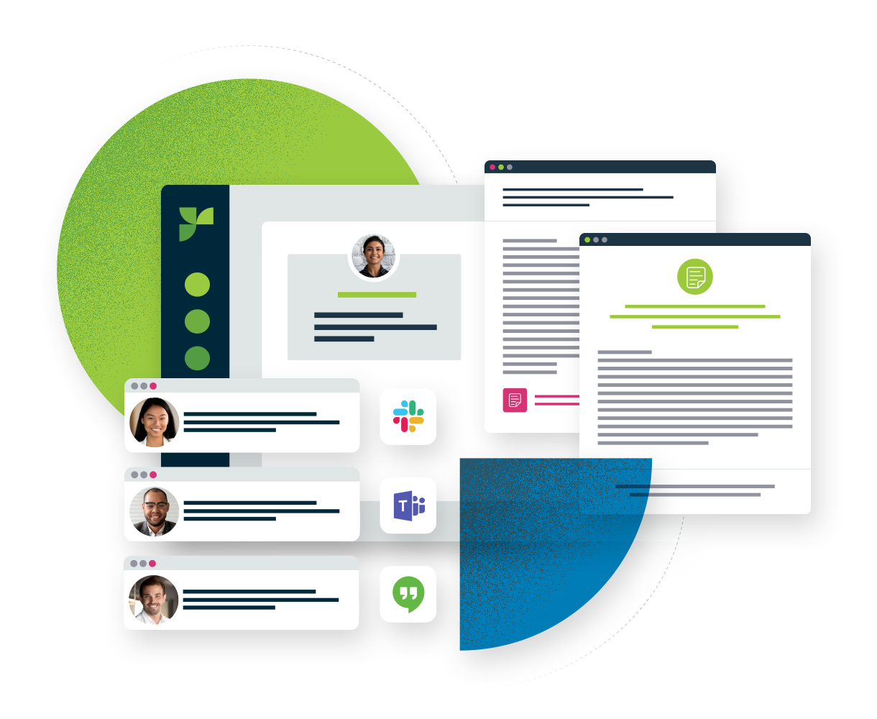
What is Responsive?
A transformative Strategic Response Management platform where you can confidently respond to questionnaires, bids and inquires helping you win more deals faster. Responsive is packed with features that help:
✔
Provide a trusted, single source of content
✔
Update content easily with review and governance
✔
Stay on task with project management & collaboration
✔
Improve overall efficiency & intake process
✔
Leverage previous templates & smart responses
✔
Measure results & provide full visibility into every response

Slide 9
Former Process
The New Process with Responsive!
Intake
Project
Management
Collaboration
Review
Submission
Receive email from sales representative
Open document and start working on it, send to next PM to fill in the blanks using old proposals saved on shared drive
Reach out to SMEs for help on questions via IM
Send for review via email to marketing, update changes in document
Send for review via email to stakeholders, update changes in document
Send back to customer
Estimated TAT:
3 weeks
Intake
Project
Management
Collaboration
Submission
Reporting
These are sample scenarios. Remove and insert with your current process and your intended Responsive process, bolding portions relevant to those being trained.
Intake Submission (Sales Rep) Go/No Go Decision (Bid team)
Create Project (PM) Use content library to cover repetitive questions (PM) Assign remaining questions to authors (PM)
Respond to questions (SME) Review responses (Marketing/ PM)
Send for executive review (PM + Exec)
Export responses back into document (PM)
Update/ Review formatting (Marketing/ PM)
Send back to customer
Track win/loss (PM)
Estimated TAT: 5 days

Slide 10
Why are we making this change?
SAMPLE TEXT: With Responsive, we will eliminate redundancies within our process. Rather than saving old proposals everywhere and digging them up, we will have an organized repository to access information. We can also set clear communication for anyone who needs to be pulled into the proposal.
What is the timeline for getting this program implemented?
SAMPLE TEXT: Our deadline for finalizing end user training is by the end of Q3. We expect to fully launch the process at the start of Q4.
What is specifically changing for me?
SAMPLE TEXT: You will now be responsible for reviewing and confirming content accuracy within Responsive every 90 days.
Who can I go to with questions?
SAMPLE TEXT: If you have any questions, please reach out to the proposal team at fakeemail@proposalteamemail.com.
Important FAQ
Replace the sample text provided with actual responses.

Slide 11
Additional Responsive Resources
Below you will find some valuable resources designed to guide and support users in mastering the platform effectively.
Academy
Online training platform that equips users with skills and best practices through flexible, on-demand courses.
Live Training Responsive offers weekly webinars on a variety of popular topics, including series for New Users.
Help Center
Access articles, guides, and FAQs for quick troubleshooting and product insights.
Community
A forum where Responsive users can connect, share insights, ask questions, and collaborate on best practices.

Slide 12
Setting Up Your Account
Setting Up Your Account (Slides 9-13)
Intended Audience: Any new user being introduced to Responsive. What to do: Walk through the basics of account set up. Update slides to match your preferred account requirements.

Slide 13
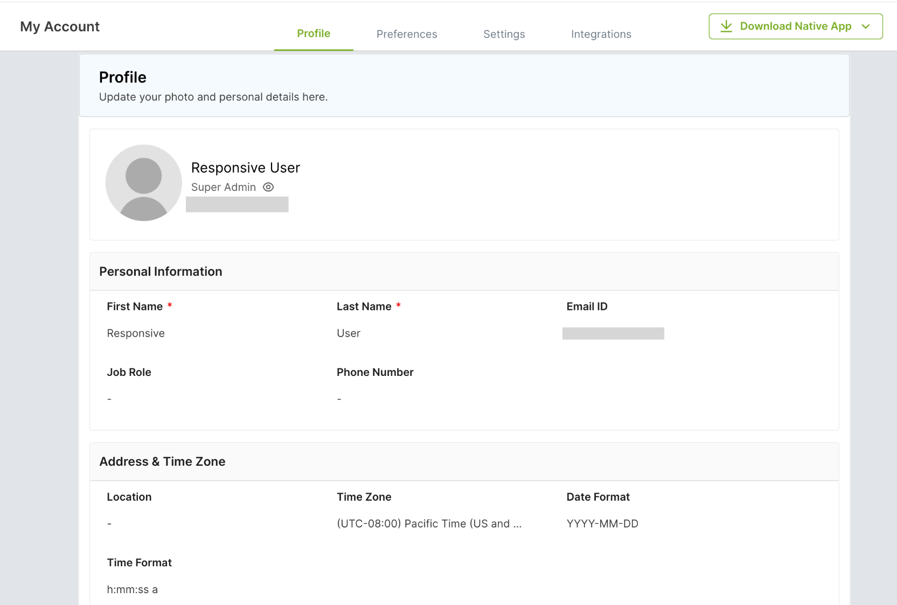
My Account
The My Account page contains each user’s settings.
Upon logging into Responsive, navigate to your avatar in the upper right corner and select my account.
Within your Profile, update:
Name
Contact Information
Timezone
Portrait image
You can customize based on what you’d like your users to update in their Profile.

Slide 14
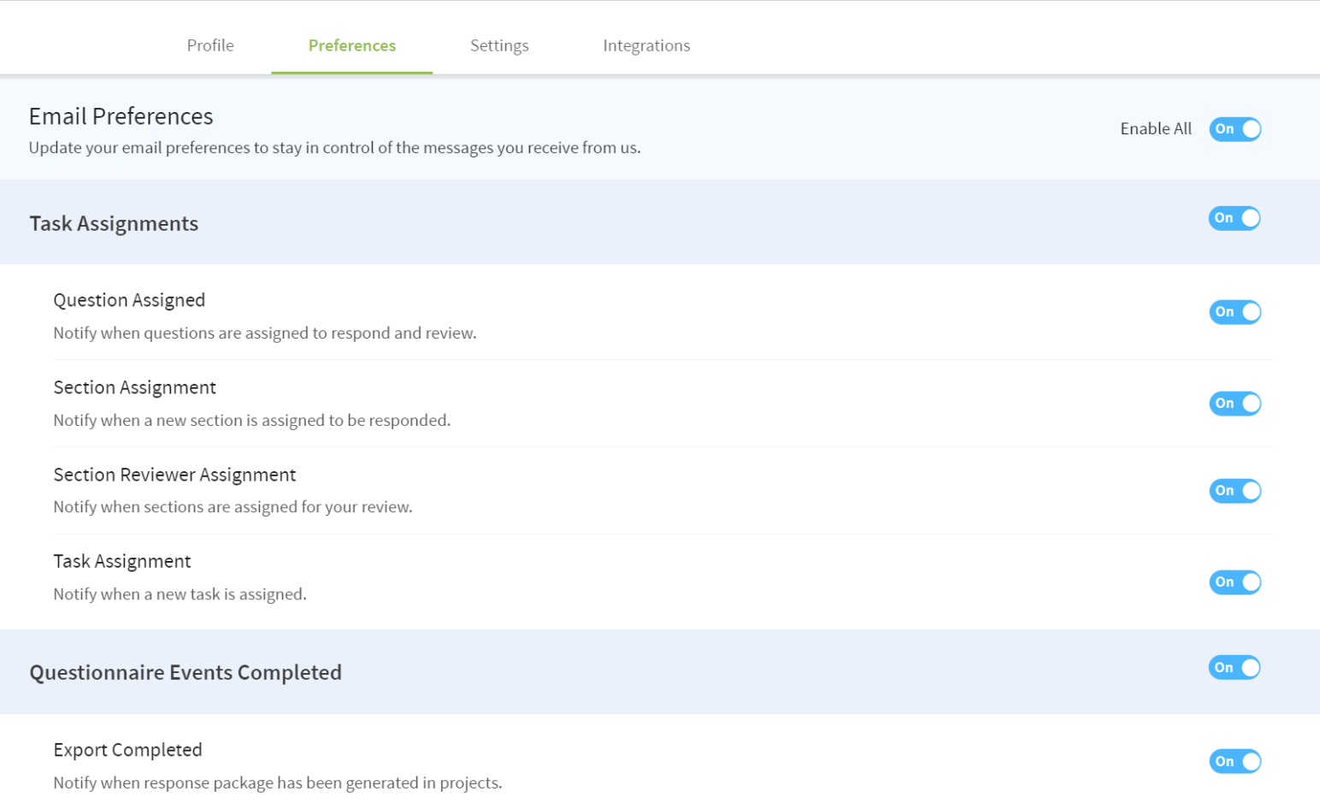
Preferences
You can manage the events that trigger email notifications, display preferences, and newsletter subscriptions on the Preferences tab.
Email Preferences
Display Preferences
Newsletter Subscription Preferences
You can customize based on what notifications you’d like to be required/ optional.

Slide 15
My Work
Navigate to the My Work page to quickly locate all Responsive tasks assigned to you.
When you first log in, Responsive displays the My Work module. It is designed to display all your tasks in one place so you can see your workload and prioritize it.
There are two views, the Project View and the Calendar View.
The Discussions pane on the right shows your open discussions.

Slide 16
Project Management
Project Management (Slides 13-23)
Intended Audience: Users who will be responsible for creating, leading and managing projects in Responsive. Tasks include creating projects, assigning work, importing and exporting. Note: Contains functionality only available to users with Manager and Admin permissions. What to do: Go through slides then show live scenarios within the platform. Use a sample or blank RFx as an example. Remove any slides you don’t need and update slides to match your process. Use these slides with the Project Collaboration slides to show the full project lifecycle.

Slide 17
What is a Project?
A Project is the process of responding to an RFx - from initial upload to assigning team members to completing tasks to final export.

Slide 18
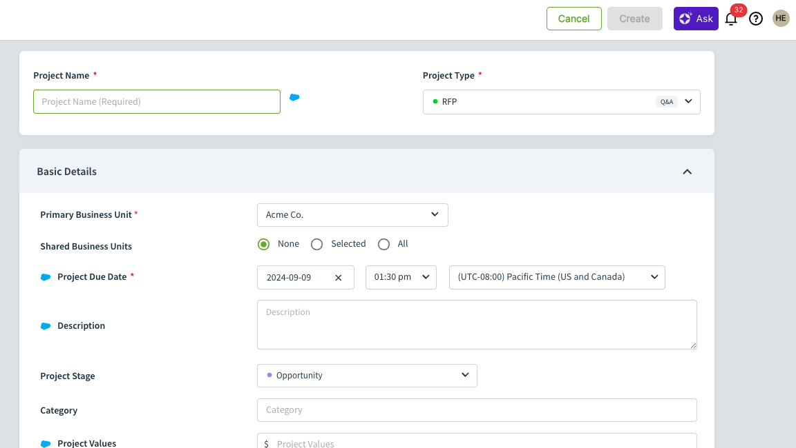
A Common Project Workflow
When it comes to managing projects within Responsive, outlining a typical response process can help the response team visualize what is to come and set general expectations.
Create
Capture project details and import project documents
Assign
Assign work to members of the project team
Respond
Project team responds to assigned work
Review
Conduct reviews of drafted responses
Complete
Wrap up project tasks and responsibilities
Share
Export your completed project and send

Slide 19
Creating a Project
The project creation/about page is where you will capture valuable information related to your project. These fields are customizable and reportable.
Reporting information (dropdown items): If you are looking to track wins/losses, project types, etc., leverage the out-of-the box fields or create new ones.
Merge tags: If you have variable information in your content library, such as [clientname], merge tags will pull information from this page and into your response
Review the Academy course on Project Custom Fields and Merge Tags for more guidance.

Slide 20
Importing Project Documents
What is mapping?
Mapping is the process of identifying all sections, questions and other necessary information from the proposal and pulling it into Responsive
Mapping Considerations:
Regardless of the type of file you are mapping in (Word/PDF or Excel), it is important to first identify:
Sections
Questions
Answer Cells (For Excel and tables only)
Review the Academy course on Project Management: Importing for detailed guidance on mapping and importing Project Documents.

Slide 21
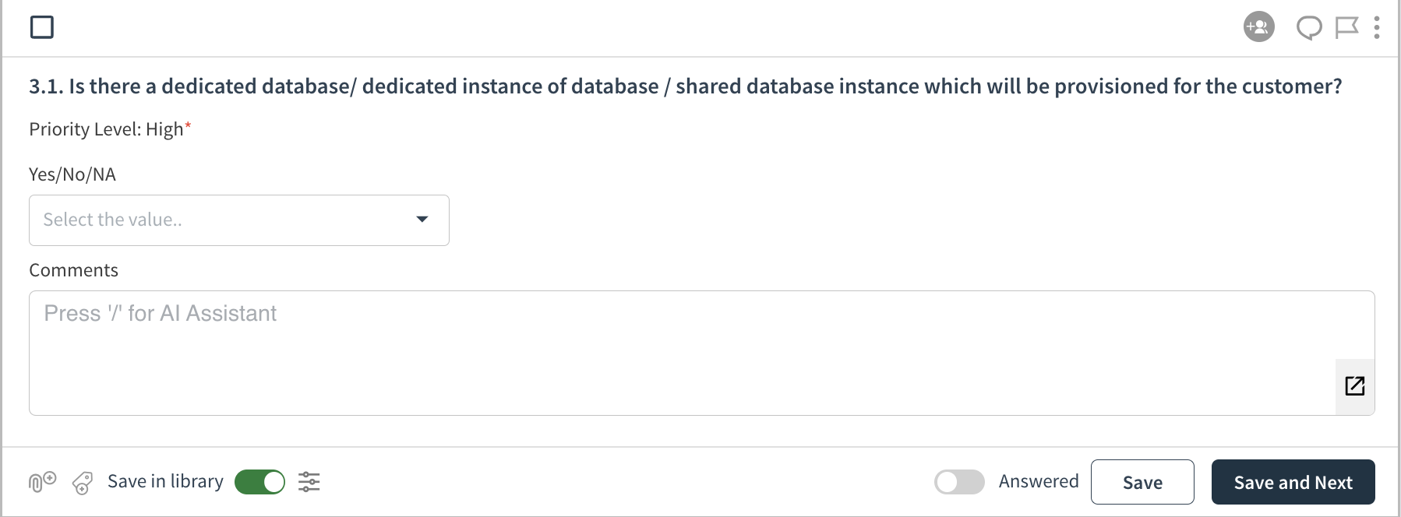
Applied Mapping
Your mapping structure impacts the question view within the project. In this example, the following was mapped:
Section: Security Requirements
Question: Is there a…
Header: Yes/No/NA + Comments
Yes/No/NA features a dropdown answer type
Comments features a Rich Text answer type

Slide 22
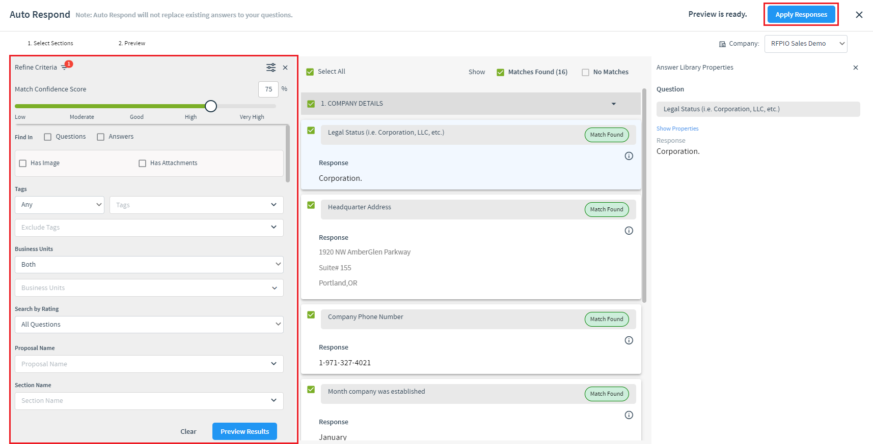
Utilizing Auto Respond
A tool that searches the Content Library to find Q&A pairs that match Questions within a Project powered by Responsive AI.
Pro Tip: Before assigning tasks, run Auto Respond as a first pass to responding. Responsive will look for content matches in the library and apply answers to as many questions as possible. Using advanced filtering and filters to guide Auto Respond will produce better results.
Review the Academy course on Using Auto Respond for more guidance.
Remove if auto respond is not part of your process/ if your content library is not yet set up.

Slide 23
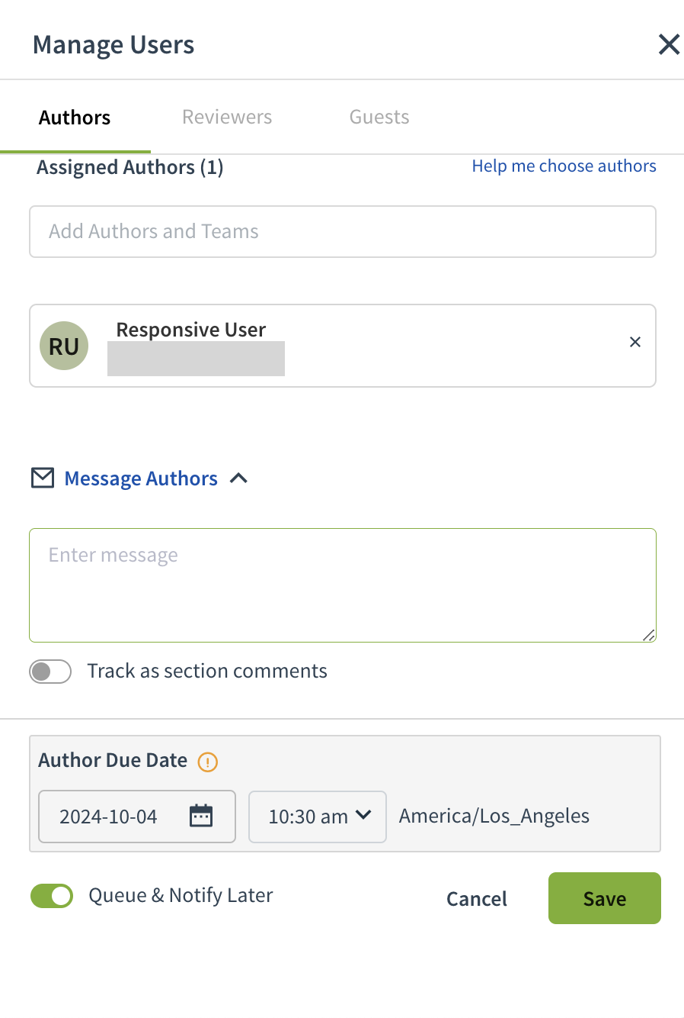
Making Assignments
Authors and reviewers can be assigned to entire sections or to individual questions. Assignments must be made in order for users to be notified of the work needing to be done within the project.
When making assignments, you have the option to configure:
Due Dates: Set deadlines for assignments.
Personal Message to Assignees: Include a custom message for the recipients.
Queue and Notify Later: This option is enabled by default. Turn it off if you want to send assignment notifications to users at the time of the assignment.
Review the Academy course on Intro to Project Workflow and Assignments for additional guidance.

Slide 24
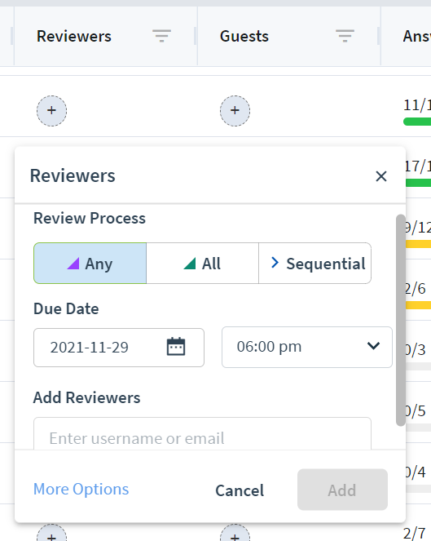
Making Assignments
Understanding project management roles is essential when developing your workflow.
Authors: The user(s) who will be responsible for completing responses for each assigned question
Multiple authors can be assigned to a single question or section
Reviewers: The user(s) who will be responsible for reviewing responses for accuracy once they have been completed by the author(s)
Multiple reviewers can be assigned to a single question or section.
Any, All or Sequential review processes can be applied.
Guest: Guests are users that do not have access to Responsive but can respond to assignments outside of the system. No login required.
Guests will only see assigned questions, applied answers and any associated comments.
Update roles information based on desired workflow for project managers.

Slide 25
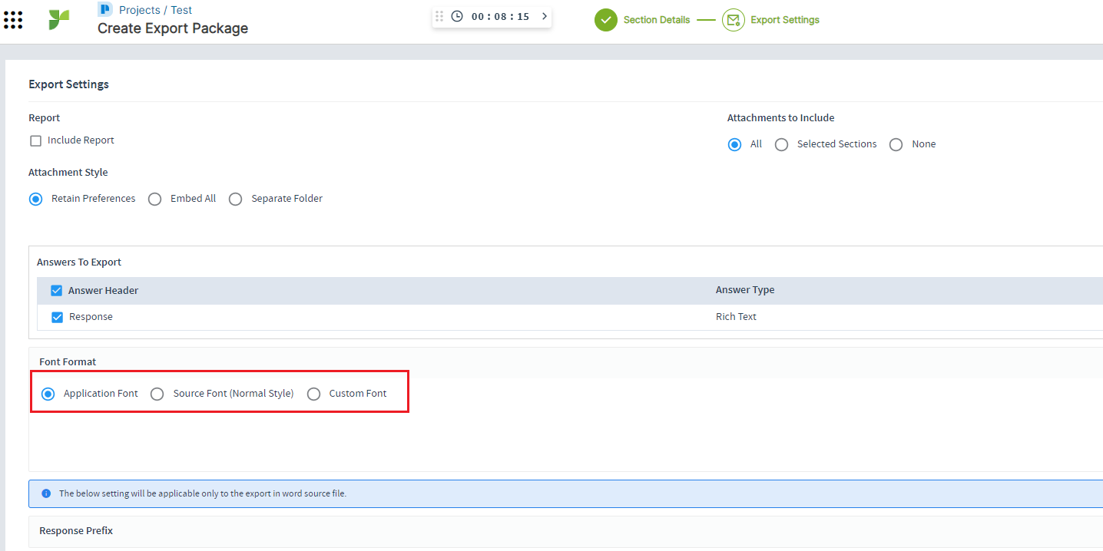
Exporting your Project
Exporting a Project to the Source File
This option will extract your responses from Responsive and plug them back into the original document.
Exporting a Project to a Template
Exporting to a Word template will pull the sections, questions and answers from the Responsive project into a branded Word document.
Navigation: Project Menu > Export
Review the Academy course on Exporting your Project for more guidance.
Customize the export option depending on your process.

Slide 26
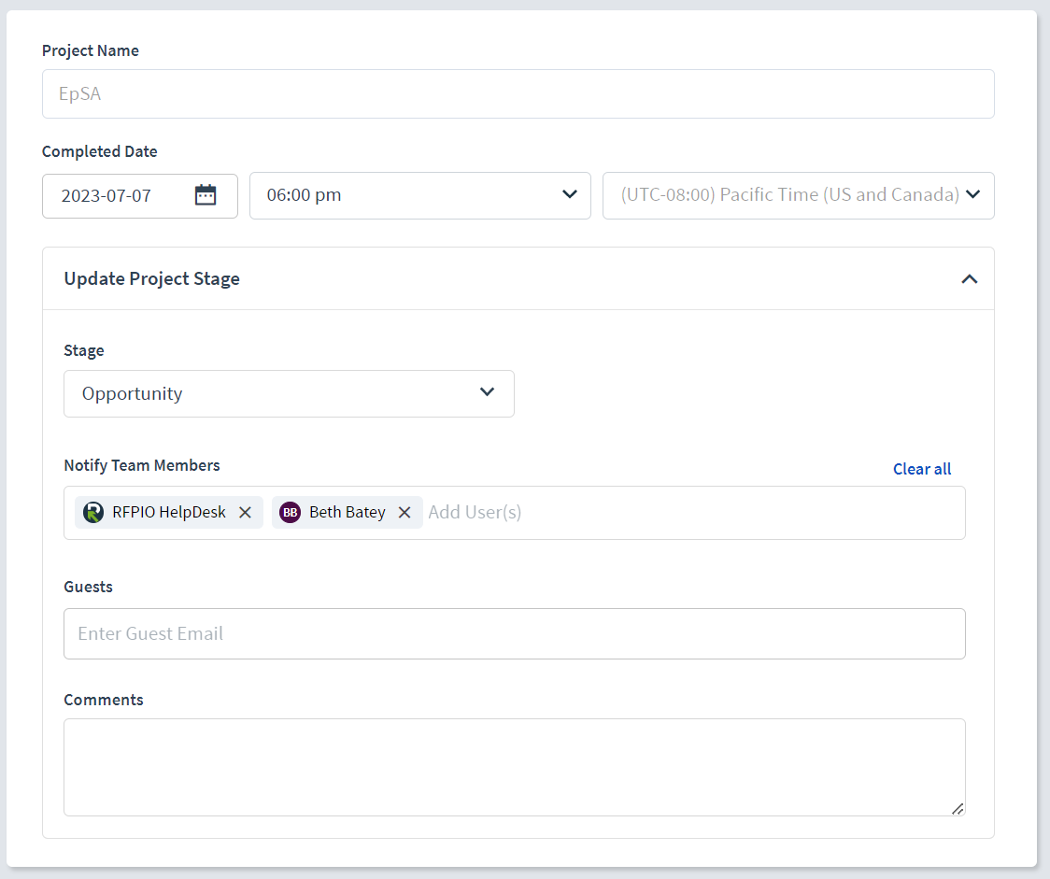
Marking Projects as Complete
After completing a project, update its status by selecting Menu > Complete Project.
After the project is marked Complete, the reporting metrics in the Executive Dashboard will be updated and saved pairs will be added to the Content Library.
Review the Academy course on Marking Projects as Complete for additional guidance.

Slide 27
Project Collaboration
Project Collaboration (Slides 24-31)
Intended Audience: Any user responsible for answering or reviewing questions within projects. What to do: Go through slides then show live scenarios in your instance environment. This is helpful if you have a live example project to walk through. Update slides based on your process. This is the only project deck you will use for authors/reviewers, however this can accompany the Project Management slides for your project managers.

Slide 28
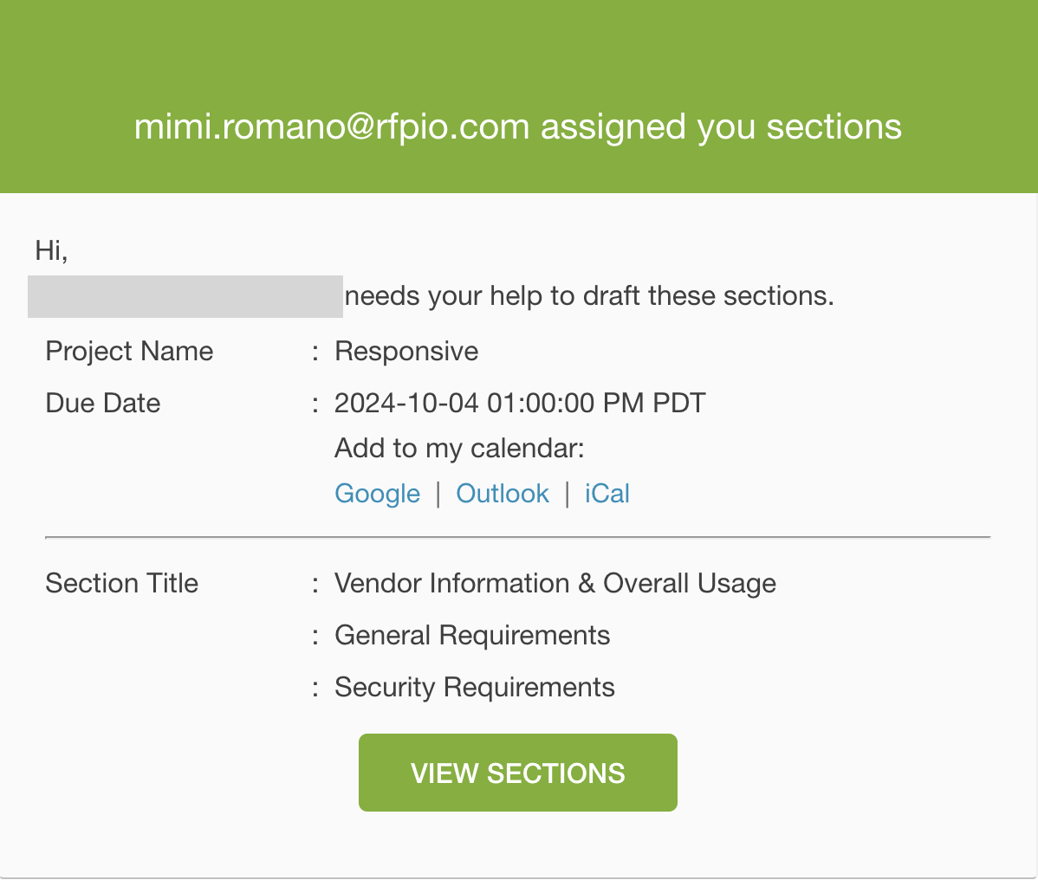
Author Role
The user(s) who will be responsible for completing responses for each assigned question
Options for Answering Questions
Drafting new Responses
Best if there is nothing already existing in your content library.
Recommendation Engine
Best for making more intentional response selections from curated content. Also helpful if AI Assistant and Auto Respond don’t deliver adequate results.
Auto Respond
Best for a first pass at responding to questions or quickly completing questionnaires.
Review the Academy course on Getting Started: Authors for additional guidance.

Slide 29
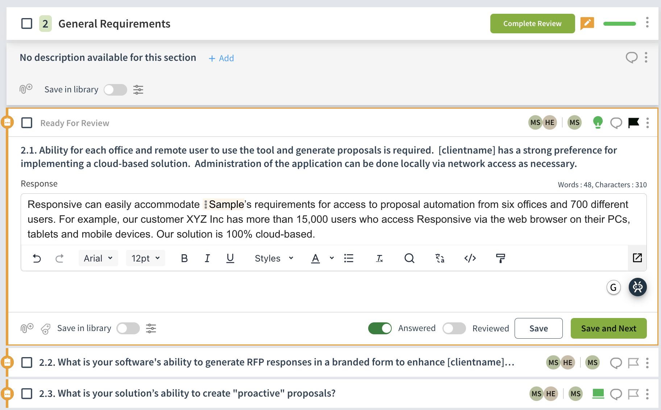
Reviewer Role
The user(s) who will be responsible for reviewing responses for accuracy once they have been completed by the author(s)
Once assigned, reviewers will have the ability to review and edit any content that has been completed by an author in the answer field. Examples of what you might be asked to review include:
Grammar
Accuracy
Saving to the Content Library
Compliance
Review the Academy course on Collaboration and Review for additional guidance.

Slide 30
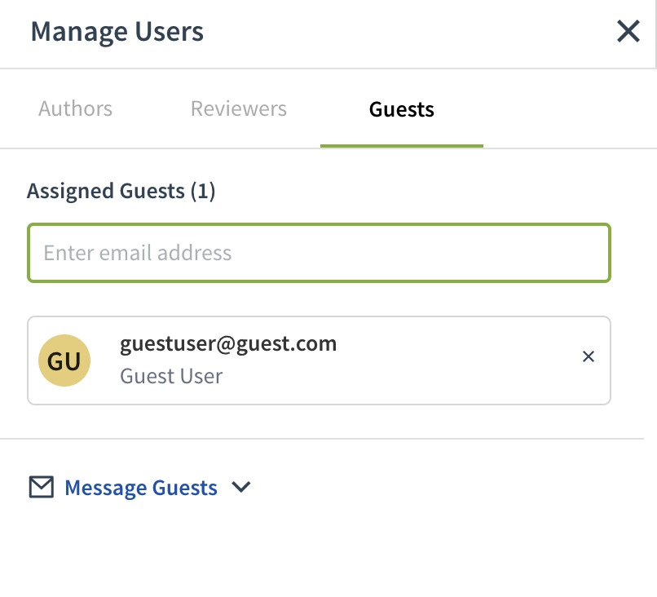
Guest Role
Guests are users that do not have access to Responsive but can respond to assignments outside of the system. No login required.
When assigned to Sections or Questions, guest users will receive an email directing them to a Guest Portal.
In the Guest Portal, they can respond to questions using rich text format and attach files if needed. They can also view content that has already been answered and post comments.
Once they submit their answers or comments, they will be reflected in Responsive.
Review the How To Guide for Guest Users.
Note that guests do not have access to collaboration features on following slides except Comments.

Slide 31
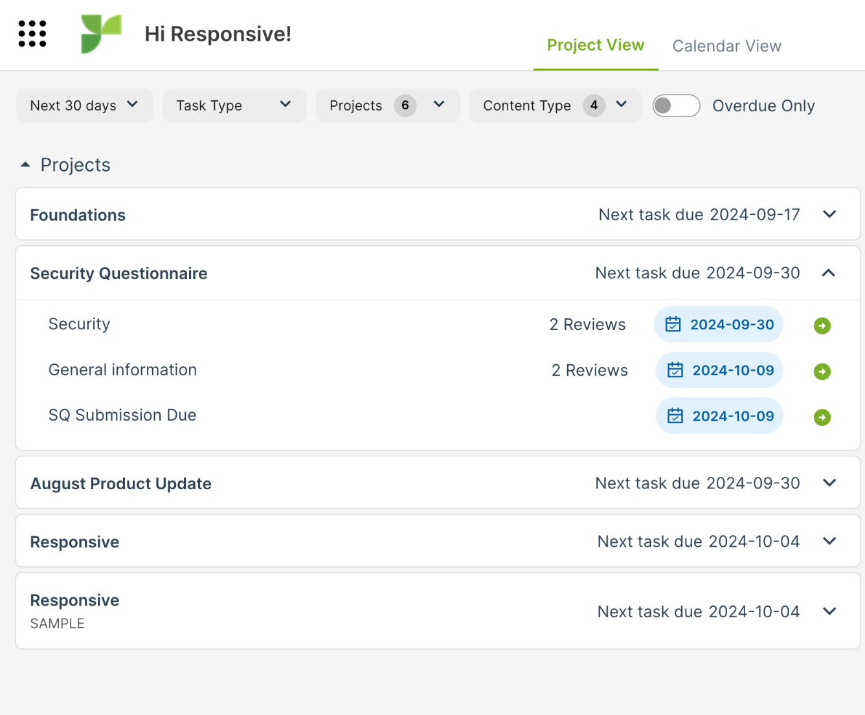
Viewing Assignments
When a Project has been created and a user has been assigned as an author or reviewer, notifications will alert the user that it’s time to get started.
Email Notifications
When email notifications are enabled within “My Account,” messages will be sent each time a new assignment has been made.
My Work
The “My Work” page is where all assigned tasks and notifications live. Simply click on an assignment to be taken directly to the corresponding task.
Projects
The “Projects” page lists all Projects a Team Member has been assigned to work on. View relevant Project details on this page or click on a Project to get started on assignments.

Slide 32
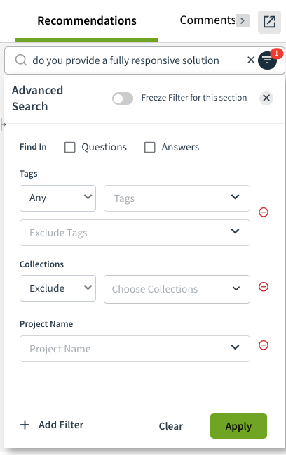
Answering and Reviewing Questions with the Recommendation Engine
The Recommendation Engine is your knowledge base in action. It automatically searches your Content Library and provides recommended answers to questions in a project.
Refine the results with advanced filters or by defining specific search criteria. To apply a response, hover over it and click "Apply Answer" (arrow icon) or "Copy" to paste it into the answer field. To replace the current answer, click the down arrow and select "Override." The chosen response will appear in the Response field, where it can be edited as needed.
Review the Academy course on Answering Questions for additional guidance.

Slide 33
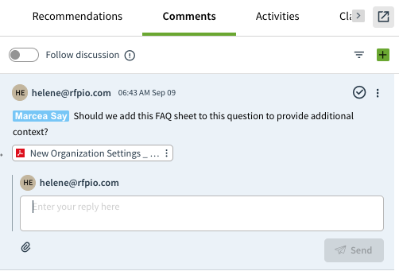
Collaboration
Got a question for a teammate? Responsive's built-in communication features keep your team synced. Send comments on specific sections or the entire project—all in one place.
Adding Comments to Questions
Leave a comment for a specific question in the right pane window.
Adding Comments to Sections
Click the three dots to the right of a section to view and create section comments.
Discussions
Navigate to Discussions in the left navigation bar to view all open comments within the project or start a new discussion.
Note: Users @mentioned in a comment can view and respond under Discussions on their My Work page and click the question to go directly to the comment.
Review the Academy course on Collaboration and Review for additional guidance.

Slide 34
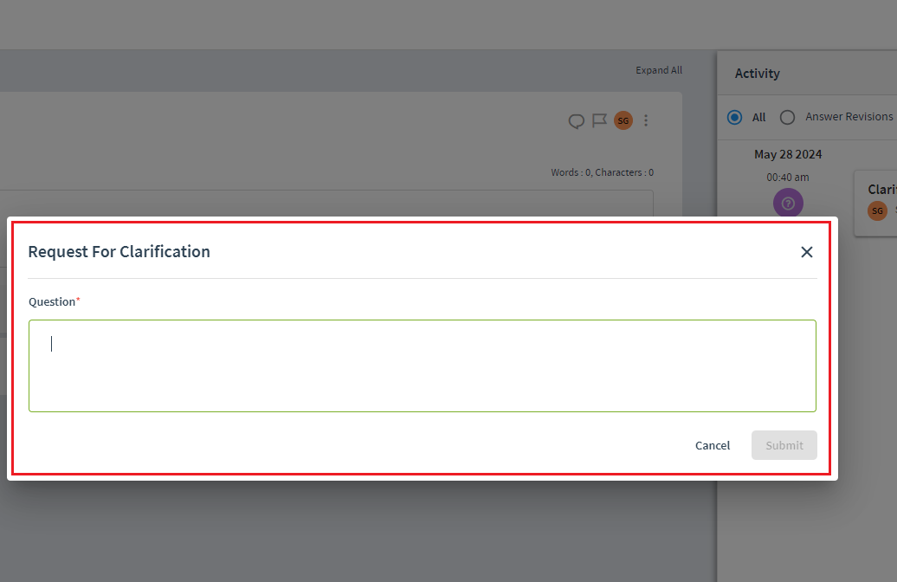
Clarifications
Use the Clarifications feature to compile and send questions to the issuer of the questionnaire to ensure you are responding appropriately.
Clarifications are for external communication with the issuer; manage internal communication using the Comments feature.
Users can submit Clarifications at the Project, Section, or Question Level.
After your team has submitted all of their Clarification questions, you can export an excel file to send back to the issuer for their response. The issuer can post responses in the document that can be uploaded back into Responsive for visibility and any necessary action.
Review the Academy course on Clarifications for additional guidance.
If clarifications are not part of your process, skip this slide.

Slide 35
Content Management
Content Management (Slides 32-37)
Intended Audience: Any user responsible for owning or adding content in the library. Note: Contains functionality only available to users with Manager and Admin roles or ownership/moderation permissions. What to do: Go through slides and show live examples in your Content Library. It is helpful if you have examples in the Review and Moderation queue handy. Remove and slides that are not needed/ update slides to match your processes.

Slide 36
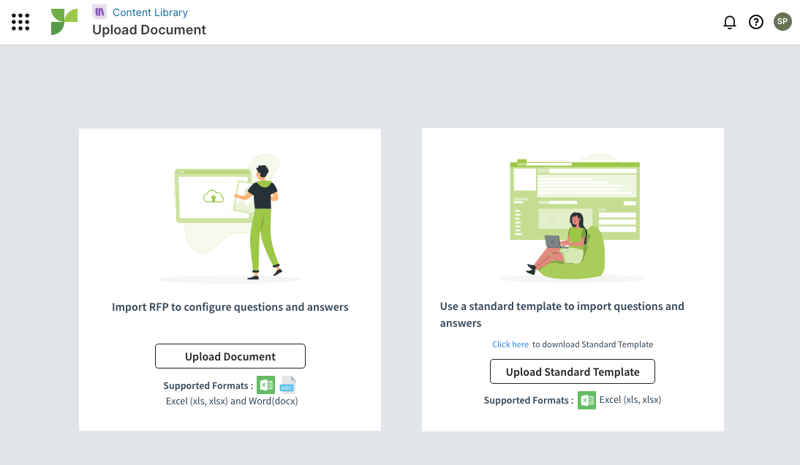
Building the Content Library
Before adding content to your library make sure it meets your quality standards, is up to date and still relevant for use. There are three primary ways to add content to your library:
Adding Individual Q&A Pairs Great for one-off additions to the library or when you need to add just a few Q&A pairs.
Importing Historical Documents Bring in past RFx that you have completed all at one time, perfect for quickly building a base of great content.
Adding Q&A Pairs from Completed Projects
Anytime you create a brand new Q&A pair while responding to a questionnaire you can choose to save it to the library for future use.
Review this Academy course to learn more about how to leverage each option.
Provide guidance on your own best practices for adding content here.

Slide 37
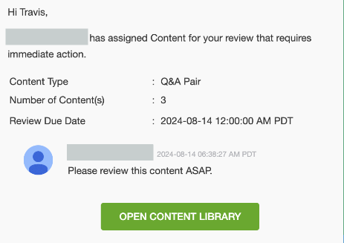
Conducting Content Reviews
Owner
Assigned users who are responsible for maintaining the accuracy and usability of a Q&A pair throughout its lifetime.
Review Cycle
Regularly occurring cycles during which Owners are required to review a Q&A pair and update it as needed.
Comments
Utilize Comments to collaborate with your team, ensure content is accurate and up to date.

Slide 38
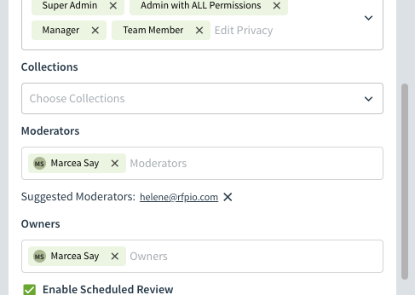
Content Review Guidelines
Review Criteria
Accuracy: Verify that the content is correct and up-to-date.
Consistency: Confirm that the content follows style and formatting guidelines.
Metadata: Confirm the following metadata fields are up-to-date
Tags
Example
Example
Add a screenshot of your instance's Q&A card here.
Customize this slide based on your preferred guidelines and criteria for Reviewers.

Slide 39
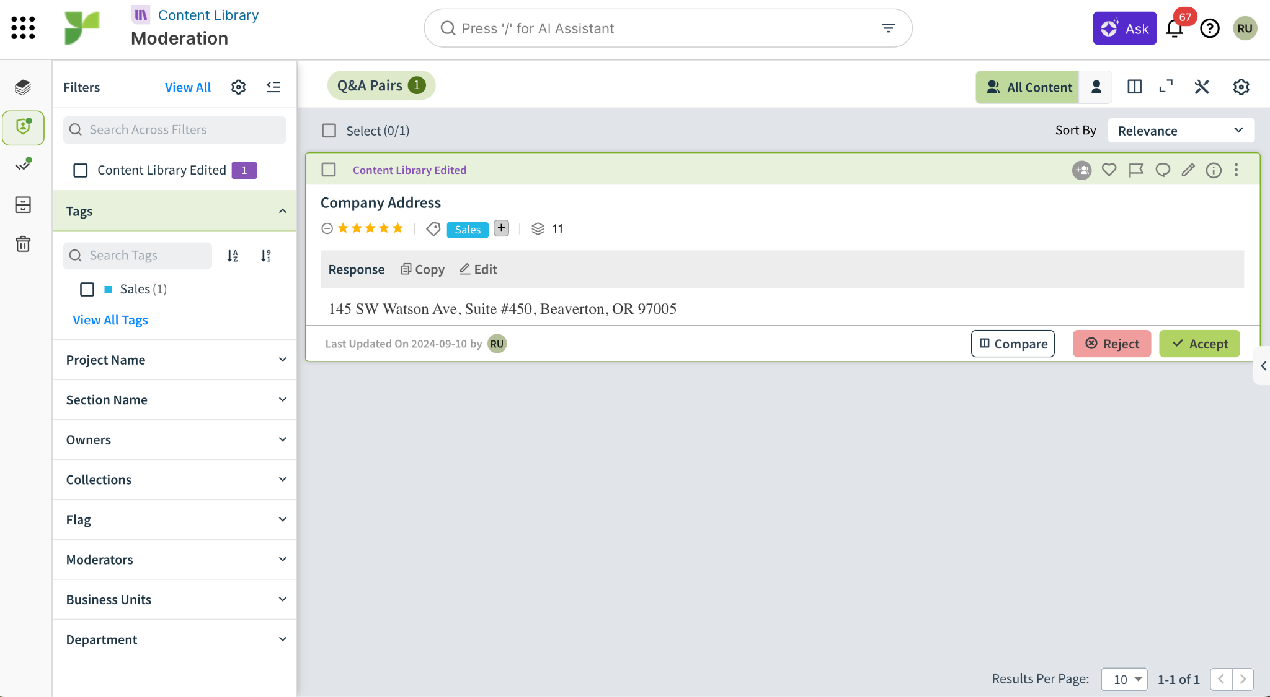
Moderation
Moderation is an optional layer of review designed to oversee changes to existing content and filter new content before it’s added to the Library.
Access to Moderation
Admins: Can access all content in moderation.
Managers and Team Members: Can access content they’ve been assigned to moderate.
Moderation Assignment
Individual: Select Individual Q/A Pair > Edit Pencil Icon > Privacy, Usage, and Review > Moderators
In Bulk: Select Content > More > Moderators > Add
Resource: Review the Academy Course on Moderation.
If moderation is not part of your process, skip this slide.

Slide 40
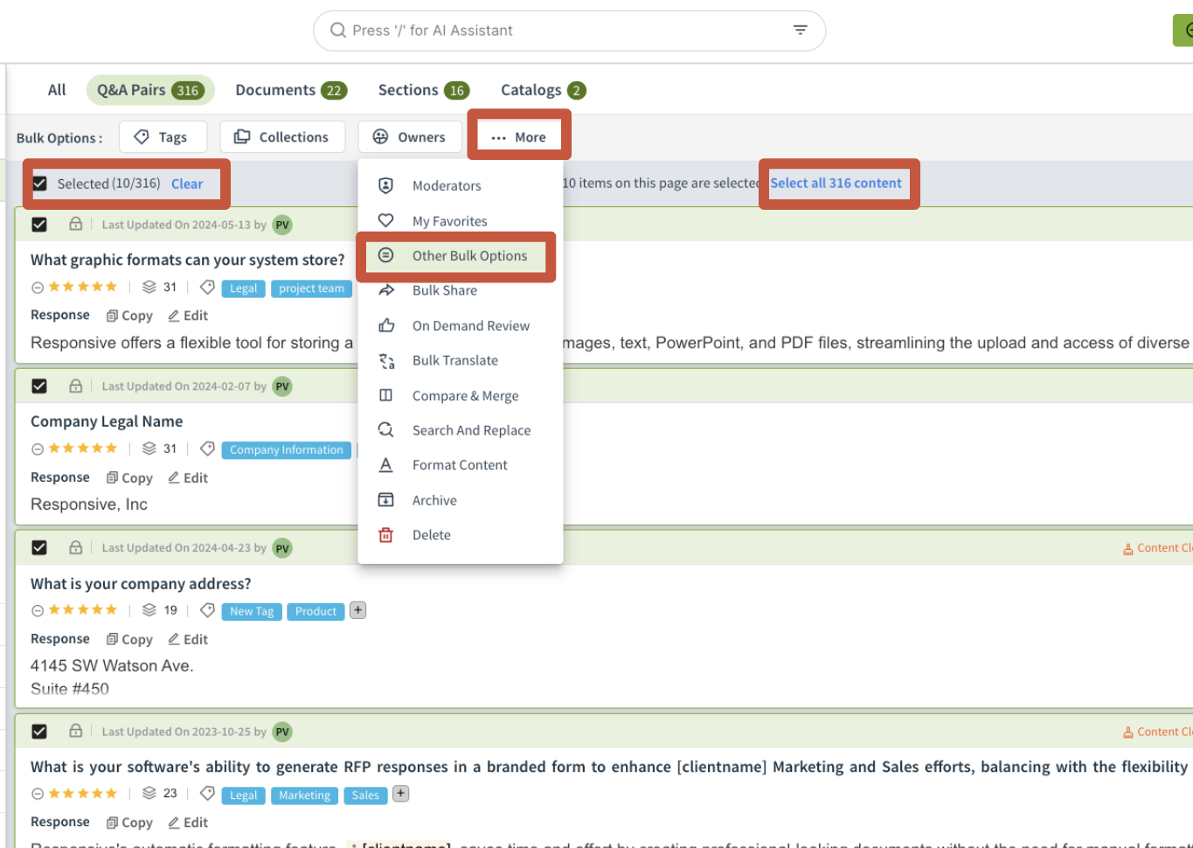
Bulk Operations
Bulk Operations allows you to make multiple changes to many Q&A Pairs and Documents all at once, saving you valuable time and maintaining consistency across content
Steps to Bulk Operations
Filter: If you are only updating a subset of content, filter down to it first with keywords, tags, etc
Select: Manually Select content using Checkboxes or use the select all option
Update: Use the More Bulk Options feature to make multiple updates at a time to content
Common Use Cases Include:
Assigning owners to content
Cleaning up answer headers
Removing specific information and replacing it with a merge tag
Updating tags
Adding alert text
Resource: Review the Academy Course on Bulk Operations

Slide 41
Content Searching
Content Searching (Slides 38-47)
Intended Audience: Any user that will have access to the content library. Recommended for all Responsive users. What to do: Walk through slides then show your own content library environment. Update slides to explain your organization structure.

Slide 42
What is the
Content Library?
The Content Library houses Question and Answer Pairs (Q&A Pairs) and documents that have been added to the Library directly or saved from Projects, making them readily accessible for use in future RFxs.

Slide 43
Searching the Content Library
Facet Filter
Keyword
Search
Advanced Search
Saved
Search
Customize the following slides based off your ideal Search Method for your users.

Slide 44
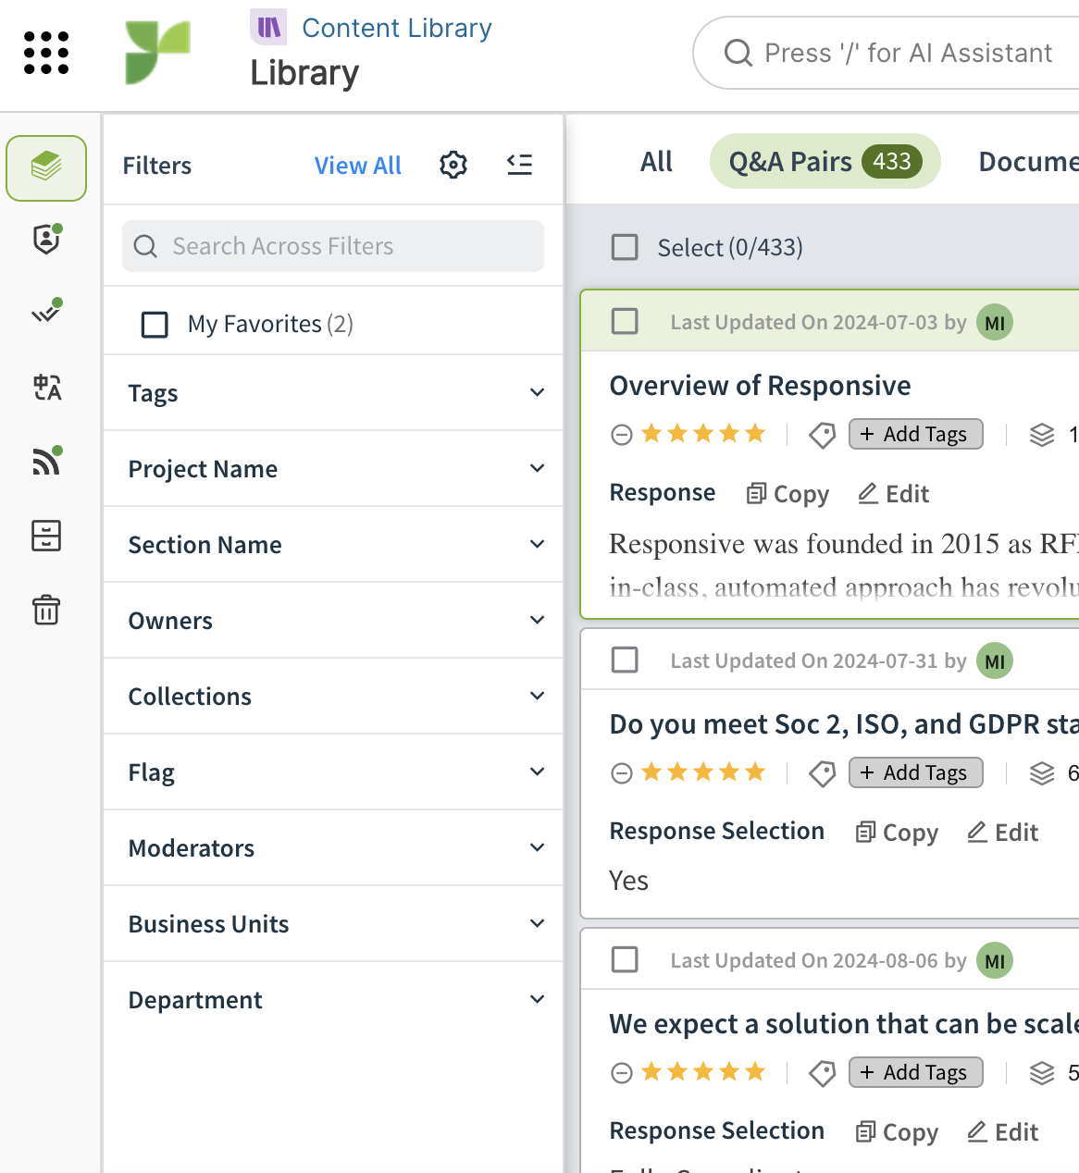
Facet Filter
This is your quick filter option to narrow down the results you are viewing in the Content Library.
Customize Facet: You can add, remove, or rearrange filters.
Utilize the search bar to search across all of your filters.
My Favorites will appear if you have marked any Q&A pairs as your favorites for easy navigation.
Popular filters include Tags, Owners, and Project Names.
Review the Academy course on Searching for Content in the Library for additional guidance.

Slide 45
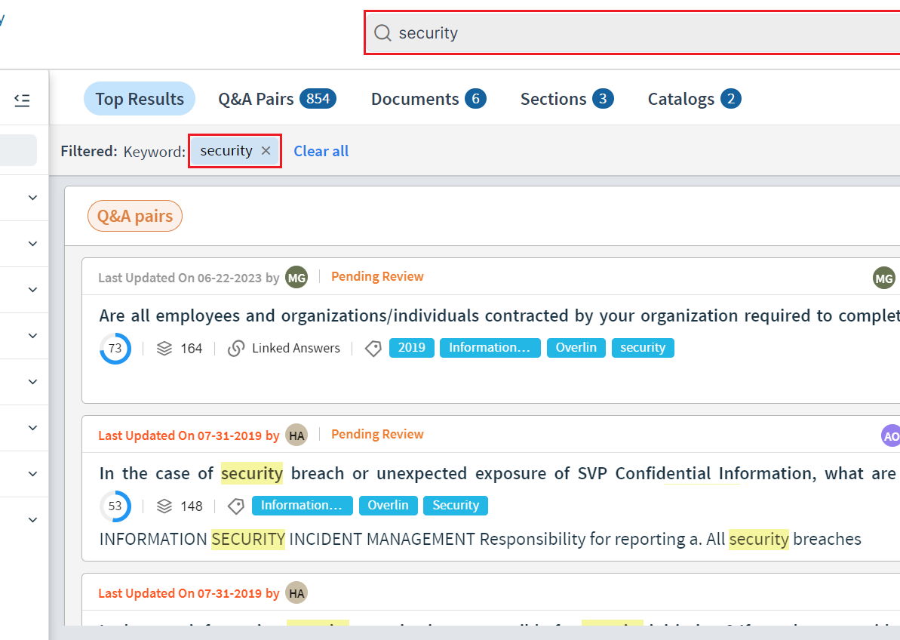
Keyword Search
Users can search in the Content Library by entering text provide custom example here in the Search field.
Type any Keyword into the Search bar to pull all results containing the Keyword.
To conduct a Phrase Search, type the phrase in quotes.
Explore this Help Article to discover advanced keyword search options, including Wildcard and Fuzzy Searches.

Slide 46
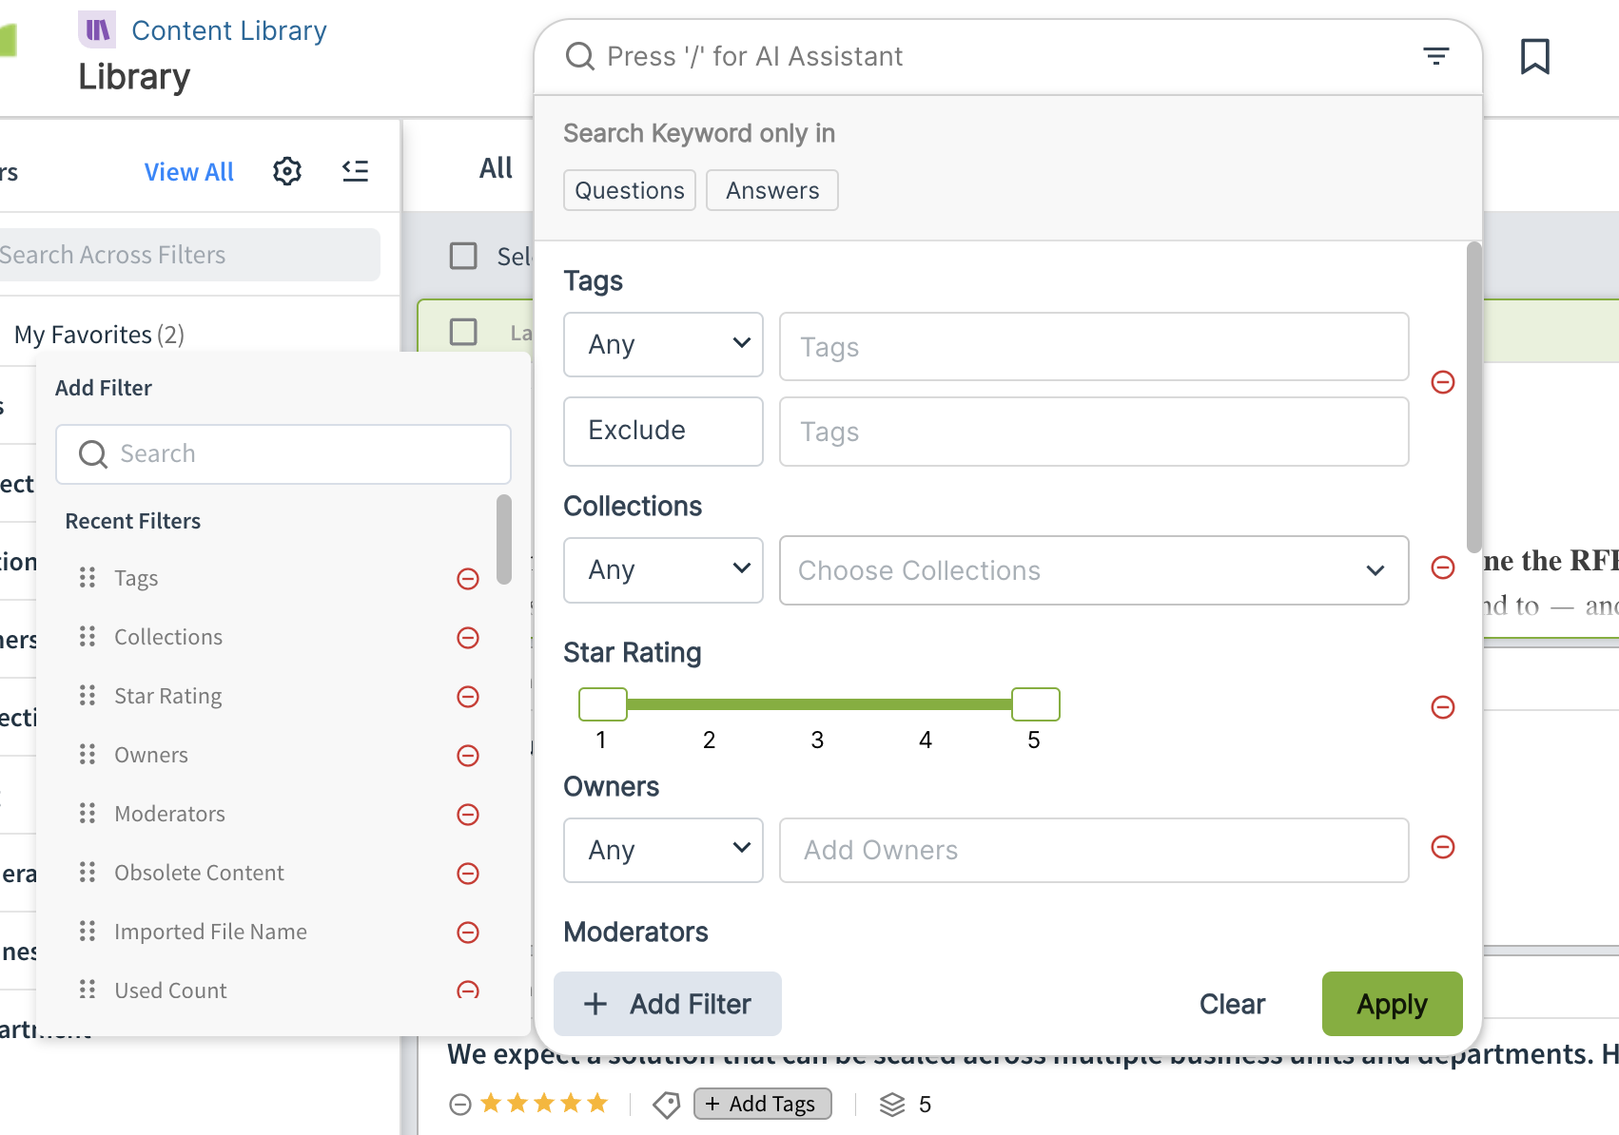
Advanced Search
Allows you to select multiple filters to apply when searching for content.
Click +Add Filter to add, remove, or rearrange filters.
Utilize the search bar alongside other filters.
Select Filter > Recently Searched to access your recently searched content.
Review the Academy course on Searching for Content in the Library for more guidance.

Slide 47
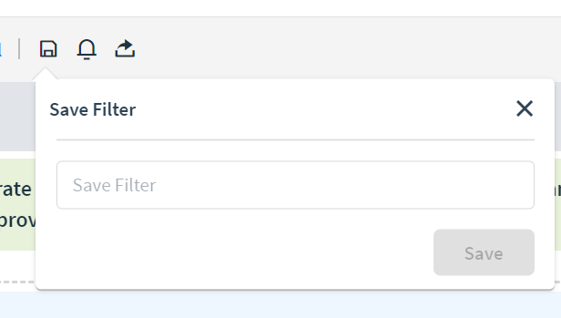
Saved Search
Save time accessing commonly searched information by creating Saved Searches.
Perfect for users who access the same information nearly every time they go into the Content Library.
Search for Content, click the Save Icon, enter the name of the search, and click Save.
Utilize the Saved Searches Icon to access your Searches.
Review the Help Center course on Saved Searches, including how to create a Default Search.

Slide 48
Tags
Add a screenshot of your instance's Tags here.
Key categories into which Q+A pairs can be divided for easy organization and retrieval.
Provide your Tag List Here.
Provide your Tag List Here.
The following slides are designed for all users to learn how to search the Content Library based on your custom content organization structure. Edit all slides to match what exists in your Content Library.

Slide 49
Collections
Add a screenshot of your instance's Collections here.
Function like a safe where Q&A pairs are stored and access is limited to users added to the collection directly
Provide description of your Collections and who has access here.
Example: We created a Legal collection, as we want to limit visibility of legal content to only users on our legal team
If Collections are not apart of your Content Organization, skip this slide.

Slide 50
Custom Fields
Add a screenshot of your instance's Custom Fields here.
Provide description of your Custom Fields here.
Example: Product: We have multiple product types, so we categorized our Q&A pairs based on the product they refer to
If Custom Fields are not apart of your Content Organization, skip this slide.

Slide 51
Additional Resources:
Intake
Additional Resources: Intake (Slides 48-49)
Intended Audience: Optional depending on process - any user in charge of managing the intake queue for projects. Note: Contains functionality only available to users with Admin permissions. What to do: Update the slides as needed to match your process. Show a live example in your Intake page.

Slide 52
Focus on winning bids
With Intake, evaluate RFPs for fit and workload. Rather than accepting and working through every bid, you can establish a bid/no-bid process for optimized win rates.
Use the customized intake form to better vet proposals to pursue, saving time and resources for proposals that matter.
“Accept” will immediately turn the intake into a project
“Reject” will send an email to the intake submitter. Make sure to provide a reason for the rejection.
Update the screenshot to your form + include any important process details needed.

Slide 53
Additional Resources:
Responsive AI
Additional Resources: Responsive AI (Slides 50-53)
Intended Audience: Optional depending on package - any role who is expected to leverage these additional resources when working in Responsive What to do: Update the slides as needed to match your process, requirements an internal security reminders. Show live examples in Responsive.

Slide 54
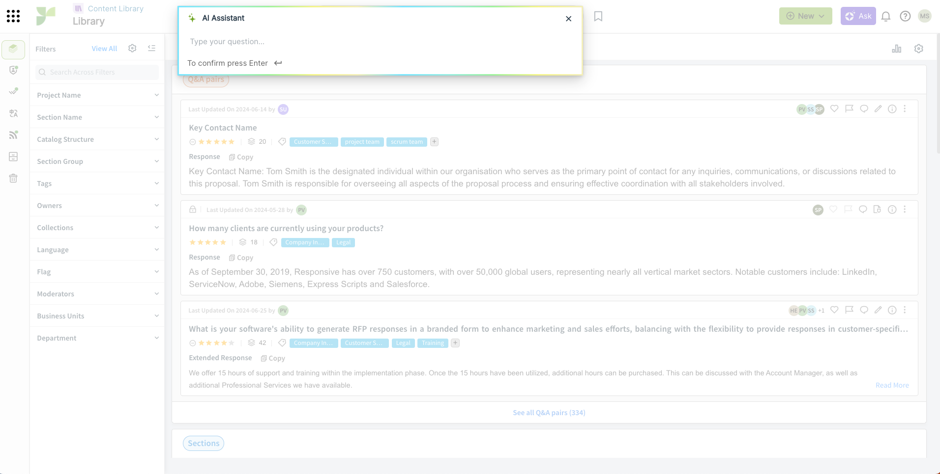
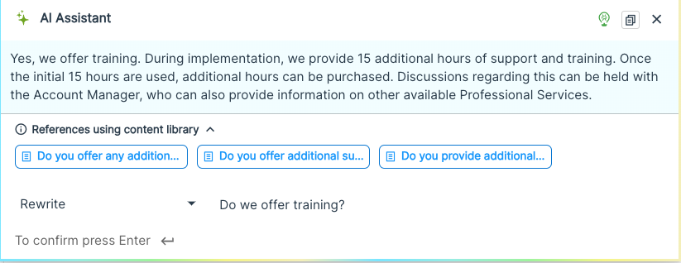
Using Responsive AI in the Content Library
Use the search bar in the content library to ask a question. The AI Assistant will search for answers based on content already available.

Slide 55
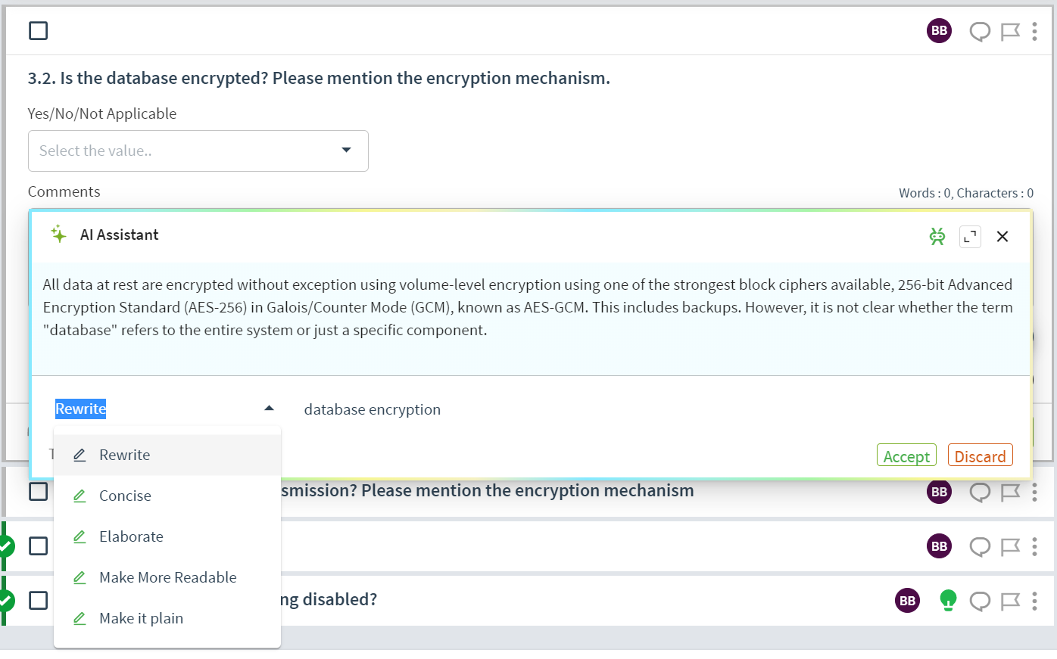
Using Responsive AI in Projects
To begin using AI Assistant, type / into the Answer field. You can add keywords to help identify the best response, then press Enter.
The AI Assistant will generate an answer for you to review. Use the 5 standard prompts to create the perfect response.
Click Accept apply the response or Discard to reject.

Slide 56
Responsive AI Best Practices
Customize this based on how you would like your team to utilize AI Assist.
Be Direct and Specific with Commands
Example: If you are looking for writing assistance, instead of asking, "Help me with creative writing," use a more specific command like "Generate a compelling introduction for a marketing proposal."
Set Parameters
Setting parameters ensures precision, relevance, efficiency, and clarity in the generated content. For example, specify a format like a bulleted list.
Provide Contextual Details
Include information such as persona identification, audience specification, and contextual instructions to optimize AI assistance.

Slide 57
Additional Resources
Responsive LookUp
Additional Resources: Responsive LookUp (Slides 54-55)
Intended Audience: Optional depending on package - any role who is expected to leverage these additional resources when working in Responsive What to do: Update the slides as needed to match your process. Show live examples of how to add LookUp in all needed places.

Slide 58
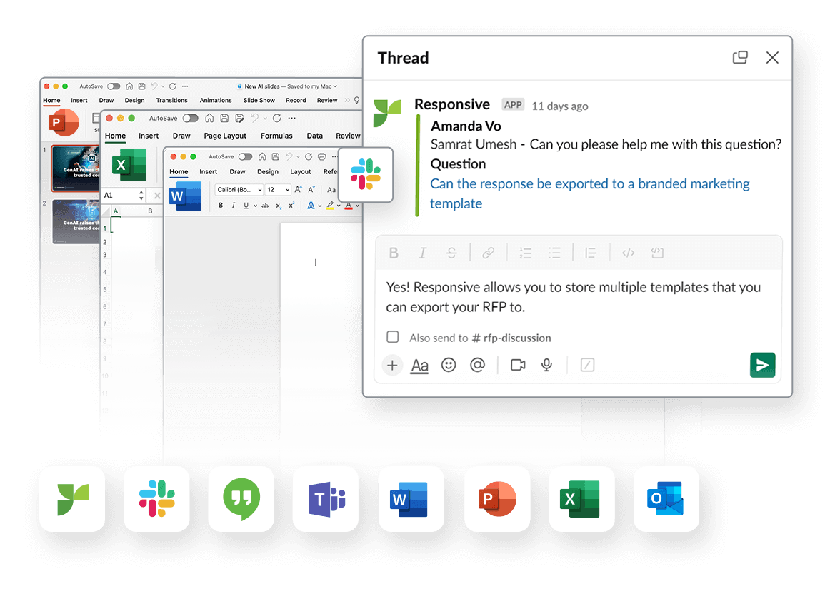
Access content faster
with Responsive LookUp
A Responsive tool that allows you to access your Content Library outside of the Responsive tool.
Bring the content library wherever you need it with the LookUp tool. Install it in your Chrome browser and entire Microsoft Suite.
Resources:
Installation Instructions
Review the Academy Course on LookUp for additional guidance.

